Slide 1
Non-regular languages
(Pumping Lemma)

Slide 2
Nonregular Languages §2.4 cp 47
学，然后知”不足”，正则语言表达能力有限
原因：FA的软硬件资源受限， the memory of a FA is limited by the number of states |Q|,
现实世界中 绝大多数语言是NRL，Which languages cannot be recognized by finite automata?
Example: L={ 0^{n}1^{n} | n∈N } NRL
‘Playing around’ with FA convinces you that the
‘finiteness’ of FA is problematic for “all n∈N”
The problem occurs between the 0^{n} and the 1^{n}
Notes:
有限状态机计算能力有限，因为存储能力受限，只能存取有限个状态，不能存取无限多个状态，也不能存取中间结果。

Slide 3
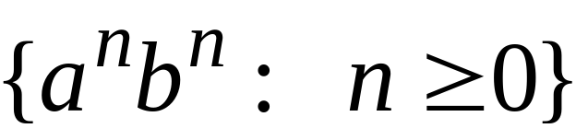
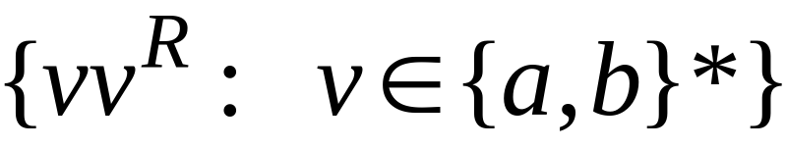


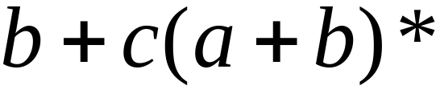

Non-regular languages
Regular languages

Slide 4

How can we prove that a language
is not regular?
Prove that there is no DFA or NFA or RE
that accepts
Difficulty: this is not easy to prove
(since there is an infinite number of them)
Solution: use the Pumping Lemma !!!

Slide 5

The Pigeonhole Principle

Slide 6


pigeons
pigeonholes

Slide 7
A pigeonhole must
contain at least two pigeons
Notes:
重复占用一个pigeonhole

Slide 8



pigeons
...........
pigeonholes
...........

Slide 9
The Pigeonhole Principle
pigeons
pigeonholes
There is a pigeonhole
with at least 2 pigeons
...........

Slide 10
The Pigeonhole Principle and
DFAs

Slide 11






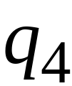


Consider a DFA with states

Slide 12




Consider the walk of a “long’’ string:
(length at least 4)
A state is repeated in the walk of

Slide 13
The state is repeated as a result of
the pigeonhole principle
Walk of
Pigeons:
(walk states)
Are more than
Nests:
(Automaton states)
Repeated
state

Slide 14

Consider the walk of a “long’’ string:
(length at least 4)
Due to the pigeonhole principle:
A state is repeated in the walk of

Slide 15
The state is repeated as a result of
the pigeonhole principle
Walk of
Pigeons:
(walk states)
Are more than
Nests:
(Automaton states)
Automaton States
Repeated
state

Slide 16
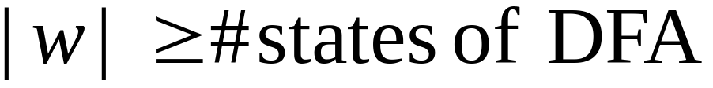

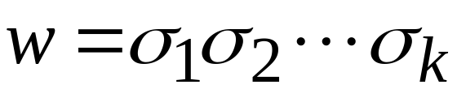












In General:
If ,
by the pigeonhole principle,
a state is repeated in the walk
Walk of
....
....
....
Arbitrary DFA
......
......
Repeated state

Slide 17
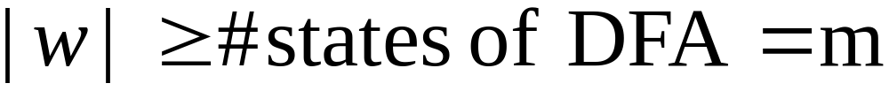


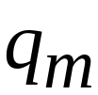

Walk of
Pigeons:
(walk states)
....
....
....
Are
more
than
....
....
Nests:
(Automaton states)
A state is
repeated

Slide 18
Pumping 定理 （思想）
言多必复 :设一个罗嗦老太婆， 脑只有n个论点，发言：”下面我讲m个意见”， m>n时，至少有一个地方在打圈, (发言激动时尤其如此），以后遇此，可笑谈：泵定理 正在工作。
正则语言是靠打圈，来描述（有某种规律的）无限集合
q_{j}
q₁
q_{k}

Slide 19
Pumping Lemma (Thm 1.37) ep78
For every regular language L, there is a
pumping length p, such that for any string
s∈L and |s|≥ p, we can write s=xyz with
1) x y^{i} z ∈ L for every i∈{0,1,2,…} 中间罗嗦 (y⁰ =ε)
2) |y| >0
3) |xy| ≤p 开讲后不久，就打圈
Note that
1) implies that xz ∈ L（重要）
2) says that y cannot be the empty string ε
Condition 3) is not always used
经得起泵测试（容忍罗嗦，有容乃正） 是RL的必要条件（但不是充分条件）
长度超过自动机状态数的单词必有一处y 打圈（真圈）

Slide 20
The Pumping Lemma

Slide 21

Take an infinite regular language
(contains an infinite number of strings)
There exists a DFA that accepts
states

Slide 22

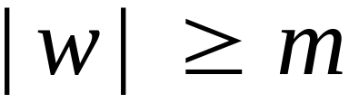
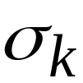

Take string with
(number of
states of DFA)
then, at least one state is repeated
in the walk of
Walk in DFA of
......
......
Repeated state in DFA

Slide 23

There could be many states repeated
Take to be the first state repeated
One dimensional projection of walk :
First
occurrence
Second
occurrence
....
....
....
Unique states

Slide 24


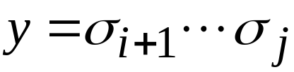
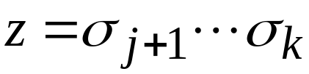
We can write
One dimensional projection of walk :
First
occurrence
Second
occurrence
....
....
....

Slide 25





In DFA:
contains only
first occurrence of
...
...
...
...

Slide 26


Observation:
length
number
of states
of DFA
...
Unique States
...
Since, in no
state is repeated
(except q)

Slide 27

Observation:
length
Since there is at least one transition in loop
...

Slide 28
We do not care about the form of string
may actually overlap with the paths of and
...
...

Slide 29

Additional string:
The string
is accepted
Do not follow loop
...
...
...
...

Slide 30

Additional string:
The string
is accepted
Follow loop
2 times
...
...
...
...

Slide 31

Additional string:
The string
is accepted
Follow loop
3 times
...
...
...
...

Slide 32
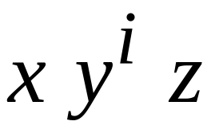


In General:
The string
is accepted
Follow loop
times
...
...
...
...

Slide 33
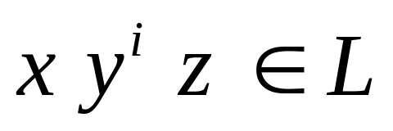
Therefore:
Language accepted by the DFA
...
...
...
...

Slide 34
In other words, we described:
The Pumping Lemma !!!

Slide 35


The Pumping Lemma:
Given a infinite regular language
there exists an integer
(critical length)
for any string with length
we can write
with and
such that:
Notes:
这样才能保证用有限个状态描述无限长的字符串。泵定理是正则语言的必要条件，不是充分条件。

Slide 36
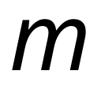
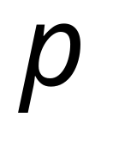
In the book:
Critical length = Pumping length

Slide 37
Applications of the Pumping Lemma

Slide 38
Observation:
Every language of finite size has to be regular
(we can easily construct an NFA
that accepts every string in the language)
Therefore, every non-regular language
has to be of infinite size
(contains an infinite number of strings)

Slide 39

Suppose you want to prove that
An infinite language is not regular
1. Assume the opposite: is regular
2. The pumping lemma should hold for
3. Use the pumping lemma to obtain a
contradiction
4. Therefore, is not regular

Slide 40


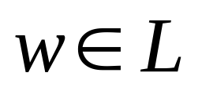
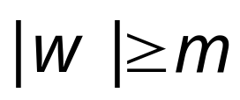
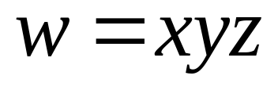
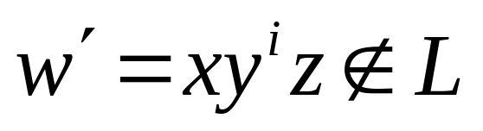
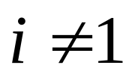
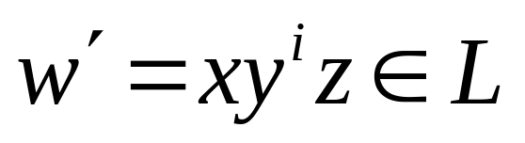
Explanation of Step 3: How to get a contradiction
1. Let be the critical length for
2. Choose a particular string which satisfies
the length condition
3. Write
4. Show that
for some
5. This gives a contradiction, since from
pumping lemma

Slide 41

Note:
It suffices to show that
only one string
gives a contradiction
You don’t need to obtain
contradiction for every

Slide 42

Example of Pumping Lemma application
Theorem:
The language
is not regular
Proof:
Use the Pumping Lemma

Slide 43
Assume for contradiction
that is a regular language
Since is infinite
we can apply the Pumping Lemma

Slide 44


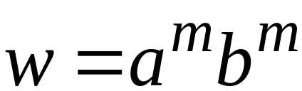
Let be the critical length for
Pick a string such that:
and length
We pick

Slide 45
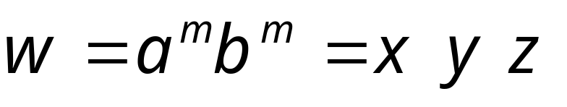

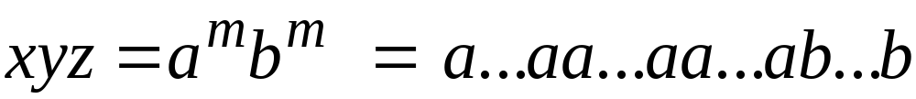

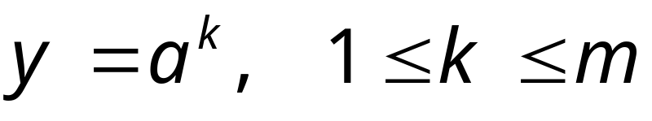
From the Pumping Lemma:
we can write
with lengths
Thus:

Slide 46
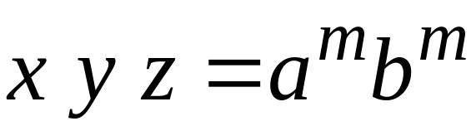

From the Pumping Lemma:
Thus:

Slide 47

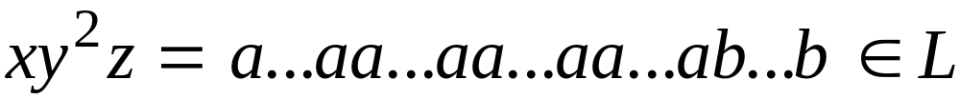
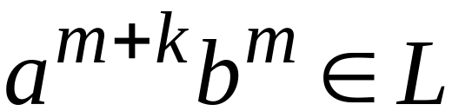
From the Pumping Lemma:
Thus:

Slide 48
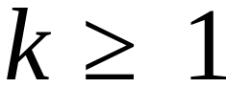
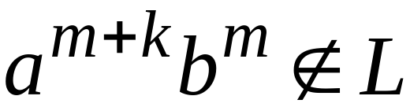
BUT:
CONTRADICTION!!!

Slide 49
Therefore:
Our assumption that
is a regular language is not true
Conclusion:
is not a regular language
END OF PROOF

Slide 50
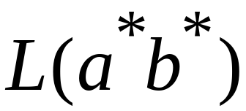
Non-regular language
Regular languages

